Slide 1
1
RECURSION

Slide 2
Recursion
1
Recursive function
  A function that calls itself, either directly, or indirectly (through another function)
Recursion
  Base case(s)
    The simplest case(s), which the function knows how to handle
  For all other cases, the function typically divides the problem into two conceptual pieces
    A piece that the function knows how to do
    A piece that it does not know how to do
      Slightly simpler or smaller version of the original problem

Slide 3
Recursion
Recursion (Cont.)
  Recursive call (also called the recursion step)
    The function launches (calls) a fresh copy of itself to work on the smaller problem
    Can result in many more recursive calls, as the function keeps dividing each new problem into two conceptual pieces
    This sequence of smaller and smaller problems must eventually converge on the base case
      Otherwise the recursion will continue forever

Slide 4
Recursion
Factorial
  The factorial of a nonnegative integer n, written n! (and pronounced “n factorial”), is the product
    n · (n – 1) · (n – 2) · … · 1
  Recursive definition of the factorial function
    n! = n · (n – 1)!
    Example
      5! = 5 · 4 · 3 · 2 · 1
      5! = 5 · ( 4 · 3 · 2 · 1)
      5! = 5 · ( 4! )

Slide 5
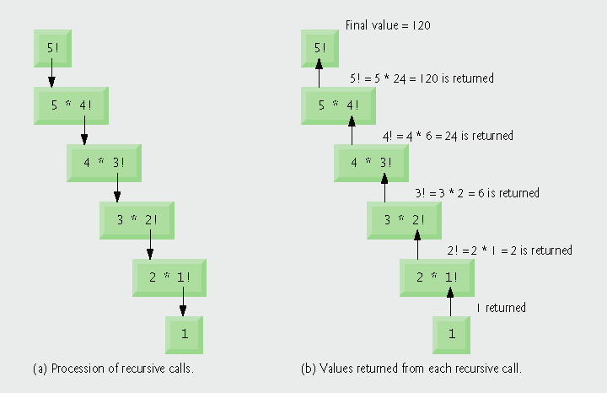
Fig. 6.28 | Recursive evaluation of 5!.

Slide 6
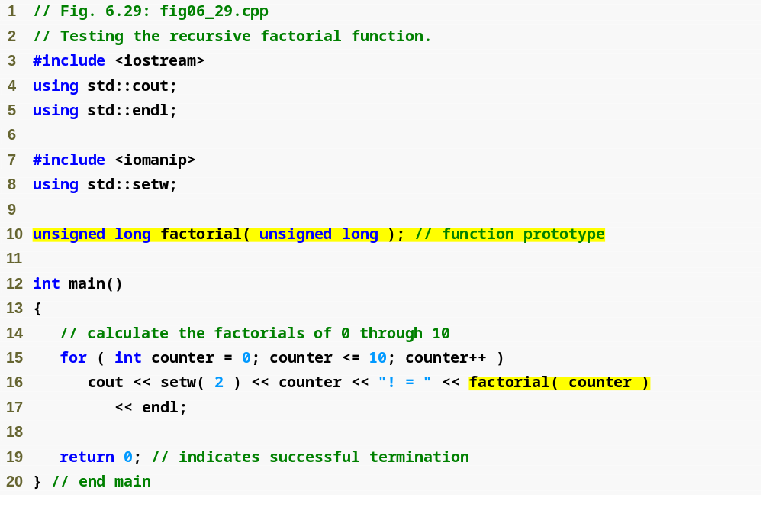
Outline
fig06_29.cpp
(1 of 2)
First call to factorial function

Slide 7
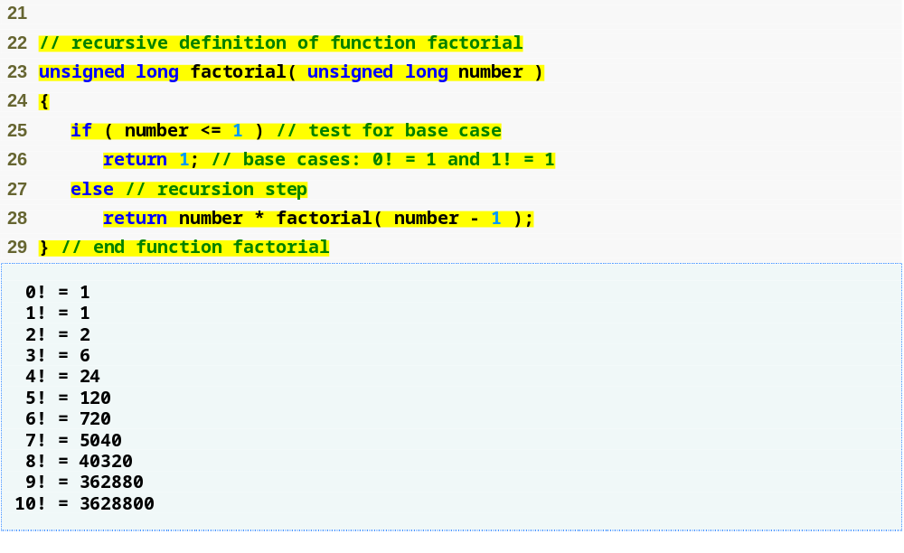
Outline
Base cases simply return 1
fig06_29.cpp
(2 of 2)
Recursive call to factorial function with a slightly smaller problem

Slide 8
Common Programming Error 6.24
Either omitting the base case, or writing the recursion step incorrectly so that it does not converge on the base case, causes “infinite” recursion, eventually exhausting memory.
This is analogous to the problem of an infinite loop in an iterative (nonrecursive) solution.

Slide 9
Example Using Recursion: Fibonacci Series
The Fibonacci series
  0, 1, 1, 2, 3, 5, 8, 13, 21, …
  Begins with 0 and 1
  Each subsequent Fibonacci number is the sum of the previous two Fibonacci numbers
  can be defined recursively as follows:
    fibonacci(0) = 0
    fibonacci(1) = 1
    fibonacci(n) = fibonacci(n – 1) + fibonacci(n – 2)

Slide 10
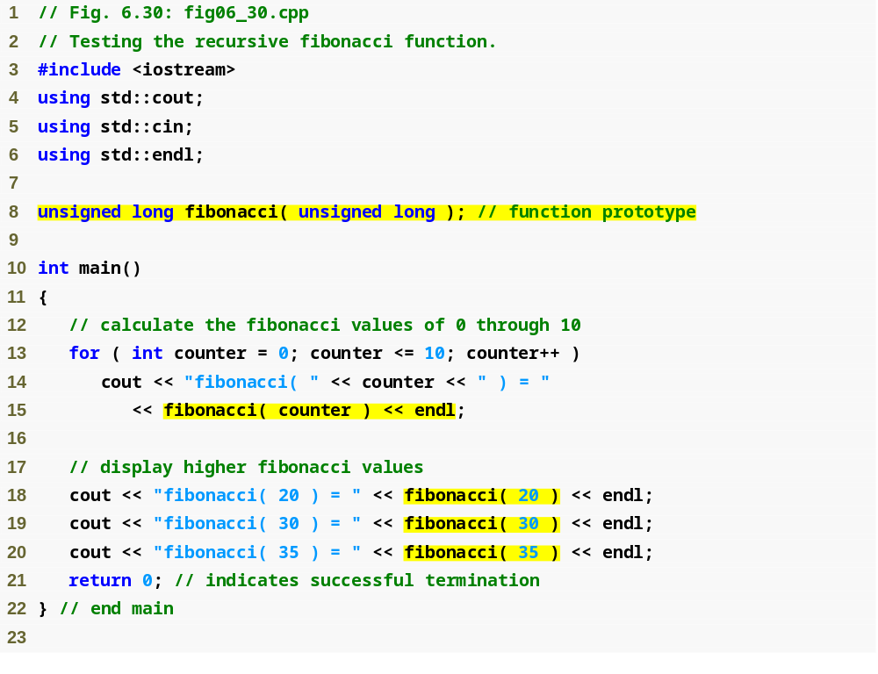
Outline
fig06_30.cpp
(1 of 2)

Slide 11
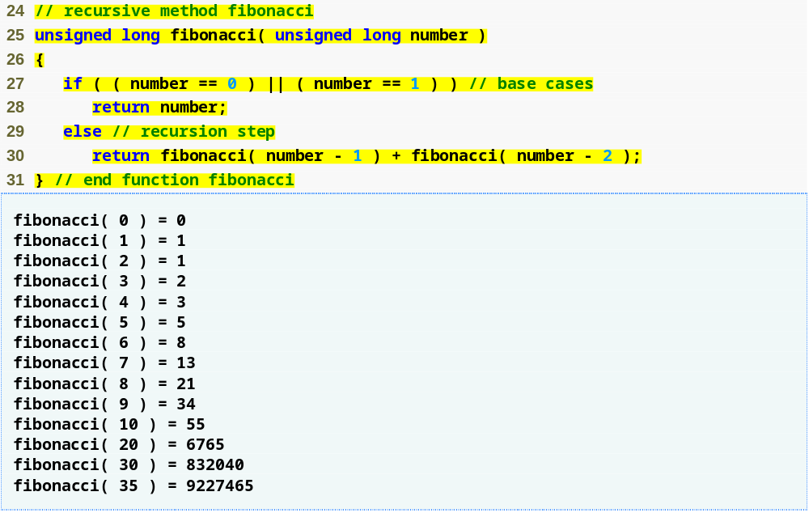
Outline
Base cases
fig06_30.cpp
(2 of 2)
Recursive calls to fibonacci function

Slide 12
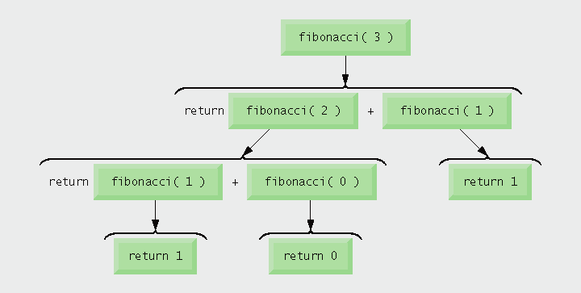
Fig. 6.31 | Set of recursive calls to function fibonacci.

Slide 13
Example Using Recursion: Fibonacci Series
Caution about recursive programs
  Each level of recursion in function fibonacci has a doubling effect on the number of function calls
    i.e., the number of recursive calls that are required to calculate the nth Fibonacci number is on the order of 2^{n}
    20th Fibonacci number would require on the order of 2²⁰ or about a million calls
    30th Fibonacci number would require on the order of 2³⁰ or about a billion calls.
  Exponential complexity
    Can humble even the world’s most powerful computers

Slide 14
Performance Tip 6.8
Avoid Fibonacci-style recursive programs that result in an exponential “explosion” of calls.

Slide 15
Recursion vs. Iteration
Both are based on a control statement
  Iteration – repetition structure
  Recursion – selection structure
Both involve repetition
  Iteration – explicitly uses repetition structure
  Recursion – repeated function calls
Both involve a termination test
  Iteration – loop-termination test
  Recursion – base case

Slide 16
Recursion vs. Iteration
Both gradually approach termination
  Iteration modifies counter until loop-termination test fails
  Recursion produces progressively simpler versions of problem
Both can occur infinitely
  Iteration – if loop-continuation condition never fails
  Recursion – if recursion step does not simplify the problem

Slide 17
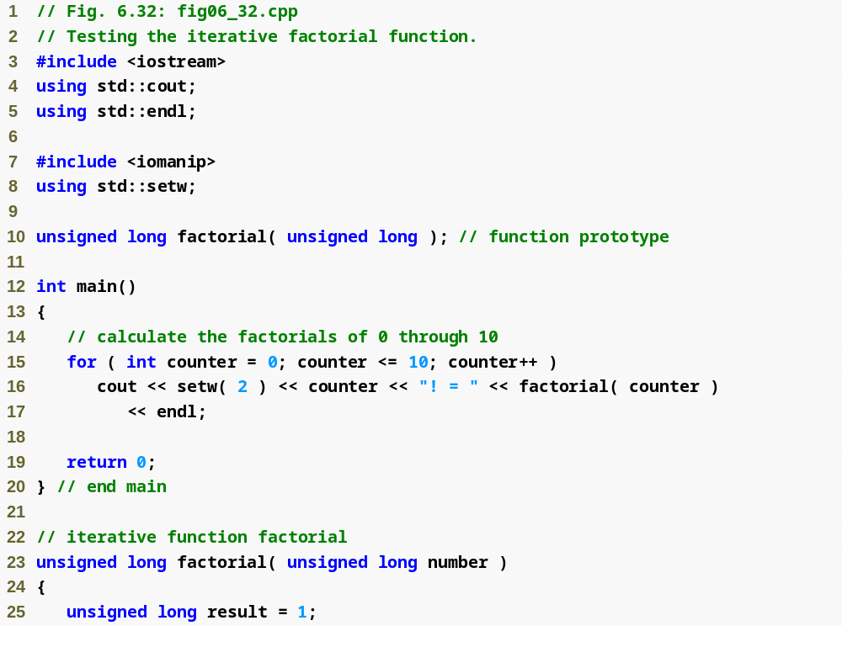
Outline
fig06_32.cpp
(1 of 2)

Slide 18
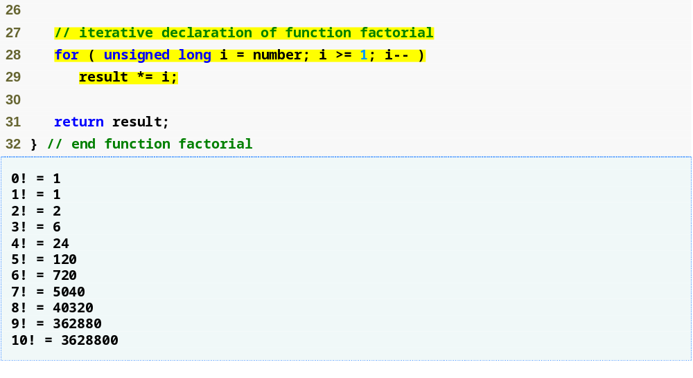
Outline
Iterative approach to finding a factorial
fig06_32.cpp
(2 of 2)

Slide 19
Recursion vs. Iteration
Negatives of recursion
  Overhead of repeated function calls
    Can be expensive in both processor time and memory space
  Each recursive call causes another copy of the function (actually only the function’s variables) to be created
    Can consume considerable memory
Iteration
  Normally occurs within a function
  Overhead of repeated function calls and extra memory assignment is omitted

Slide 20
Software Engineering Observation 6.18
Any problem that can be solved recursively can also be solved iteratively (nonrecursively).
A recursive approach is normally chosen in preference to an iterative approach when the recursive approach more naturally mirrors the problem and results in a program that is easier to understand and debug.

Slide 21
Software Engineering Observation
Another reason to choose a recursive solution is that an iterative solution is not apparent.
Avoid using recursion in performance situations. Recursive calls take time and consume additional memory.

Slide 22
// This method returns the sum of 1 to n
public int sum (int n)
{
int result;
if (n == 1)
result = 1;
else
result = n + sum (n-1);
return result;
}

Slide 23
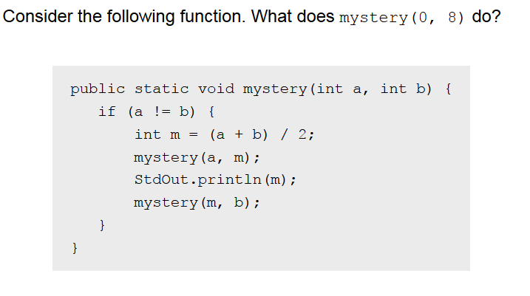

Slide 24
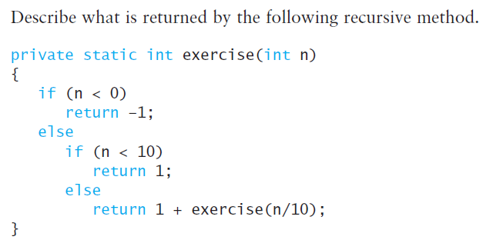

Slide 25
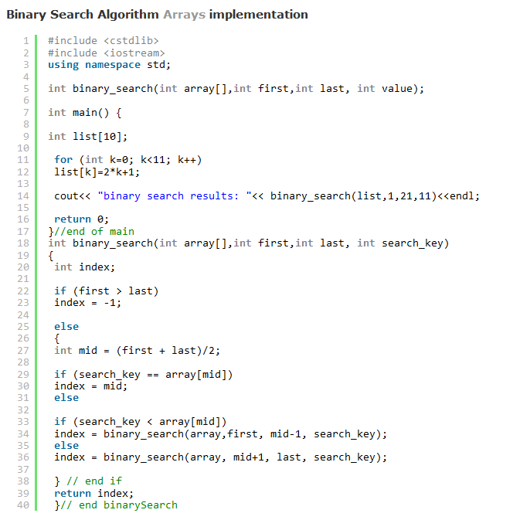
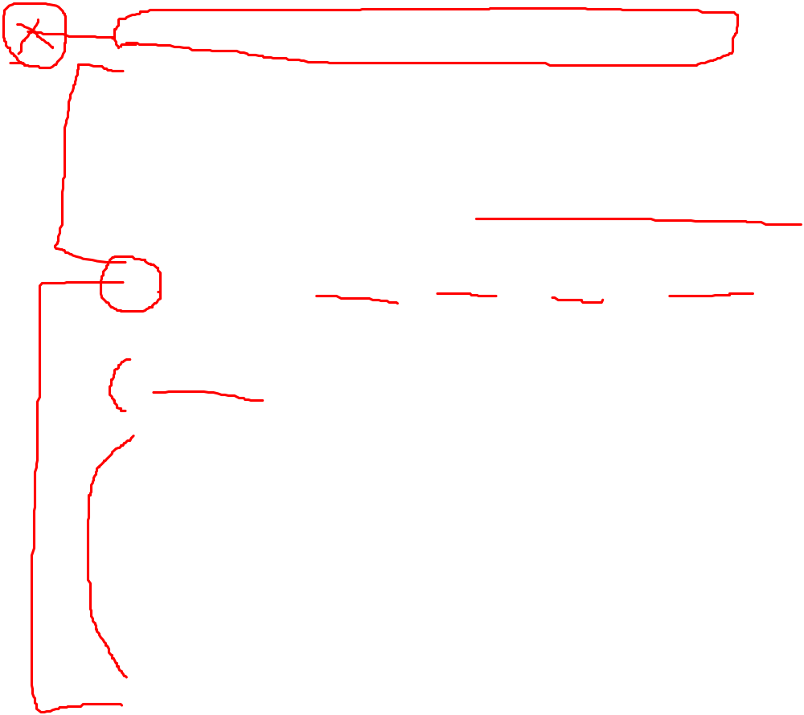

Slide 26
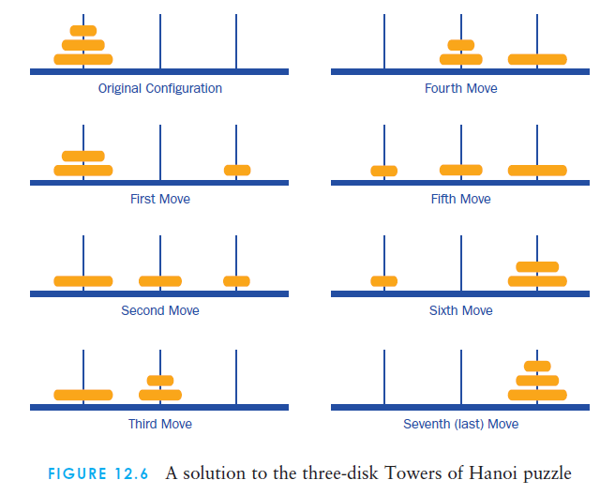
start
temp
end

Slide 27
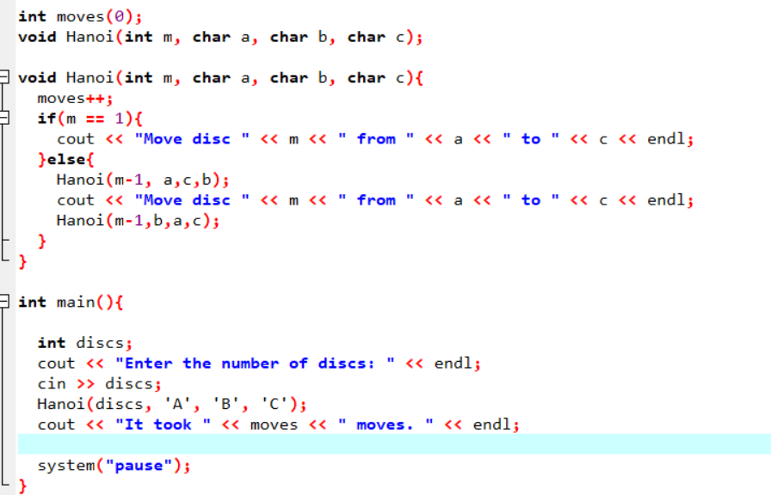
11-<number>

